Slide 1

New Clumpiness Measures and Their Application in Customer Valuation
Eric T. Bradlow
Yao Zhang
Dylan Small
The Wharton School

Slide 2

Customer Lifetime Value
It is defined as the net present value of the cash flows attributed to the relationship with a customer (Gupta et al., 2004).

Slide 3


Segmentation: RFM Analysis
Recency(R): the last time the customer purchased.
Frequency(F): number of purchase occasions.
Monetary Value(M): average dollar value spent.
BG/BB
Fader et al. (2004)
Pareto/NBD
Schmittlein et al. (1987)
BG/NBD
Fader et al. (2005)

Slide 4
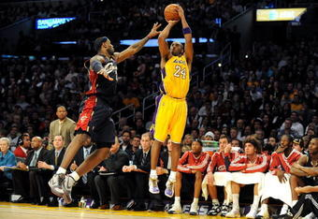
Hot Hand Measures: Do Customers Get the “Hot Hand”?
The “hot hand” effect in sports is a widespread belief that success breeds success and failure breeds failure.
The performance of a player during a particular period is significantly better than could be expected on the basis of the player’s overall record (Gilovich,
Vallone, &Tversky 1985).
But most existing measures
are criticized for their low
power thus not capable of
detecting “hot hand” effect.

Slide 5
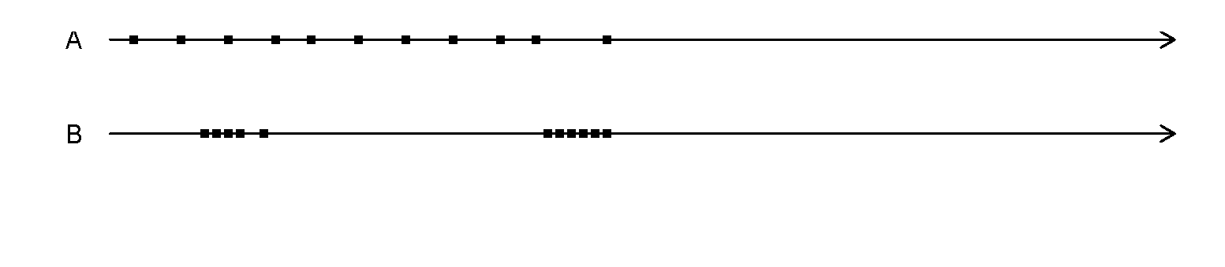
What is Clumpiness?
Both of these customers have the same values of R and F
From data perspective, the user is called clumpy when more or larger clumps of visits are observed.
Clumps of visits indicate non-constant visiting rate, specially temporary elevations of propensity --- i.e., periods during which the user is more likely to visit/purchase than his/her average level.

Slide 6
Motivation:
Why We Started Working
On This?

Slide 7
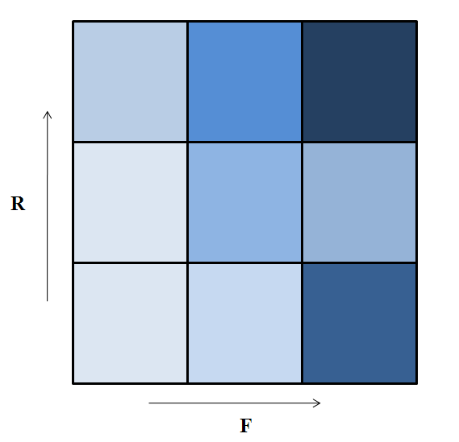
Hulu.com data
A cohort of 563 randomly selected users who registered for Hulu during the last two weeks of February 2009.

Slide 8
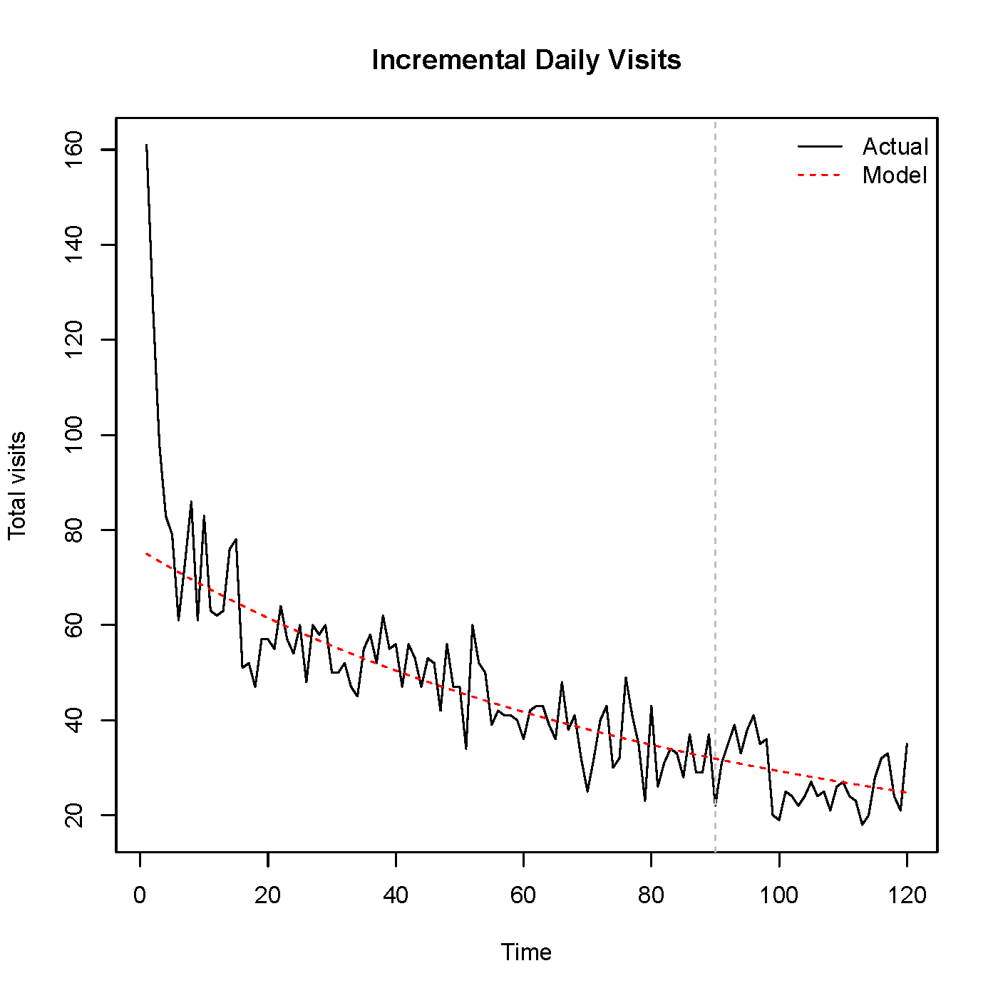
What if using “buy ‘till you die” model?

Slide 9
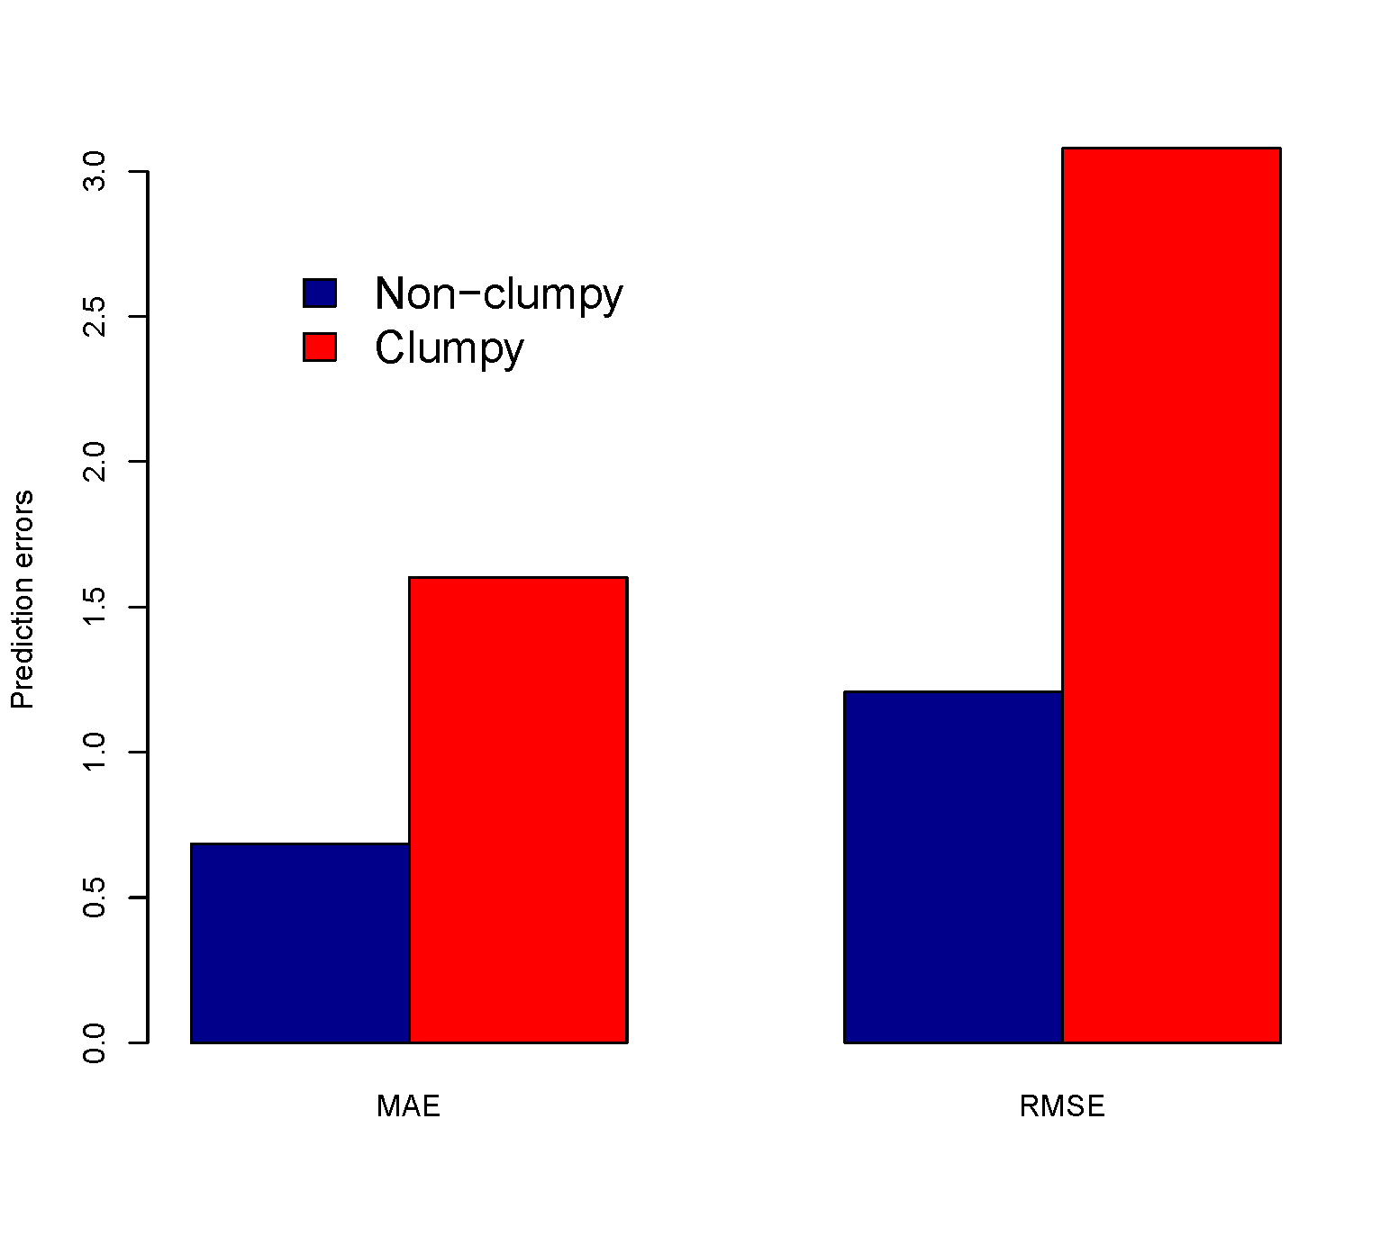
Compare Prediction Errors

Slide 10
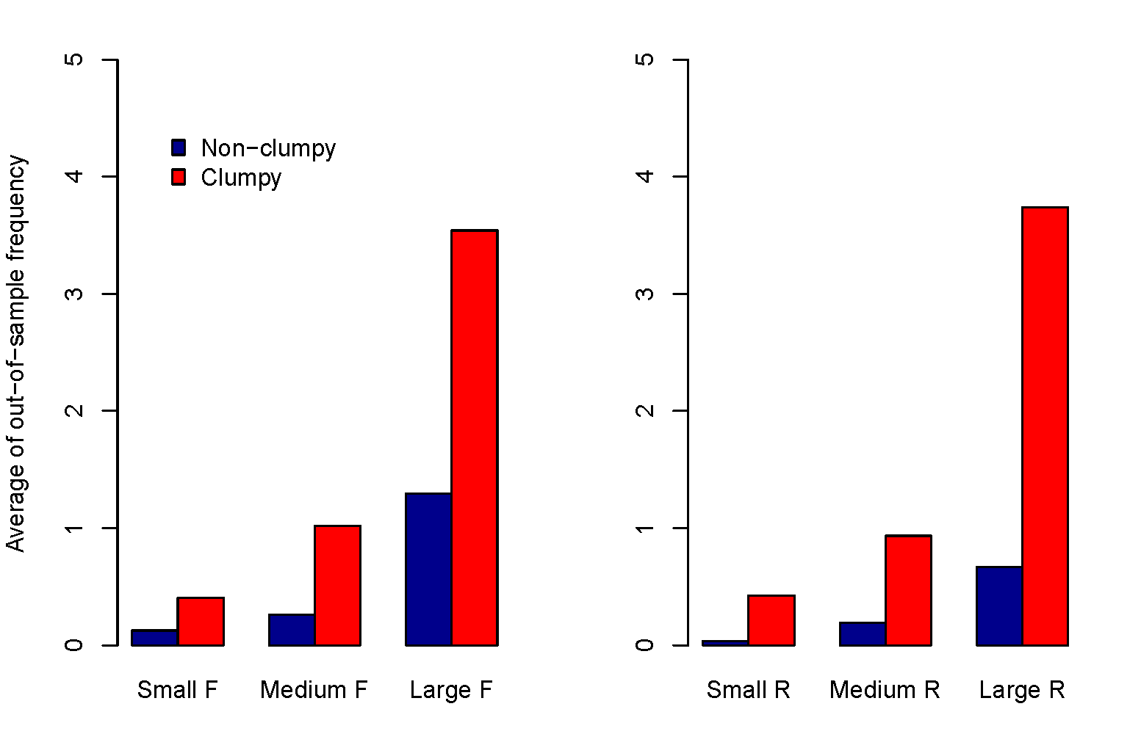
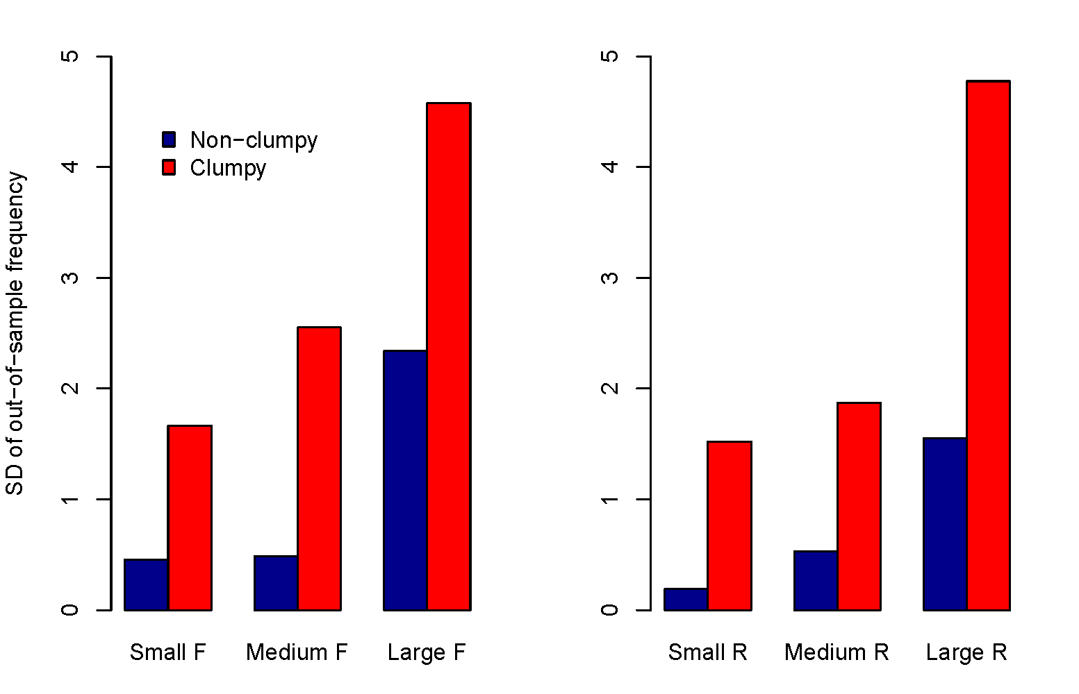
Is RFM enough?
Comparison of out-of-sample frequency, broken down by either in-sample F or R:
Non-clumpy group and clumpy group differ significantly.

Slide 11
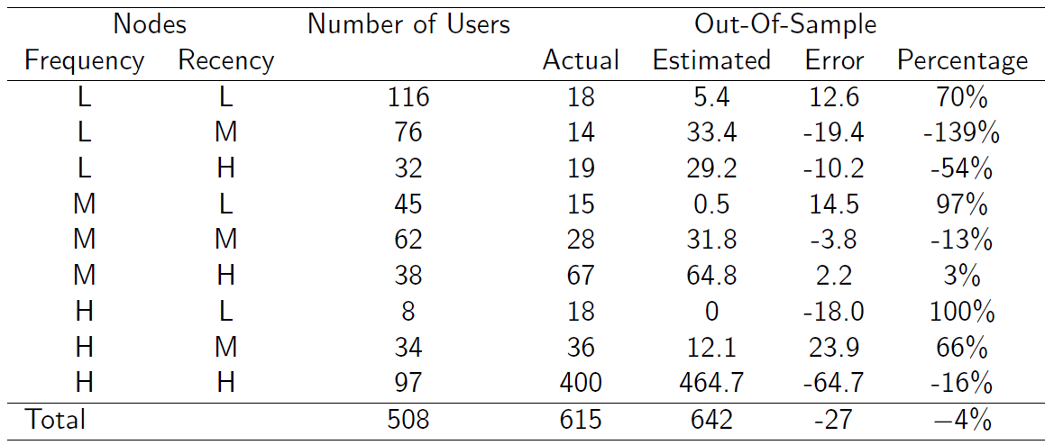
What if using “buy ‘till you die” model?
BG/BB provides accurate predictions overall, but NOT at the individual level.

Slide 12
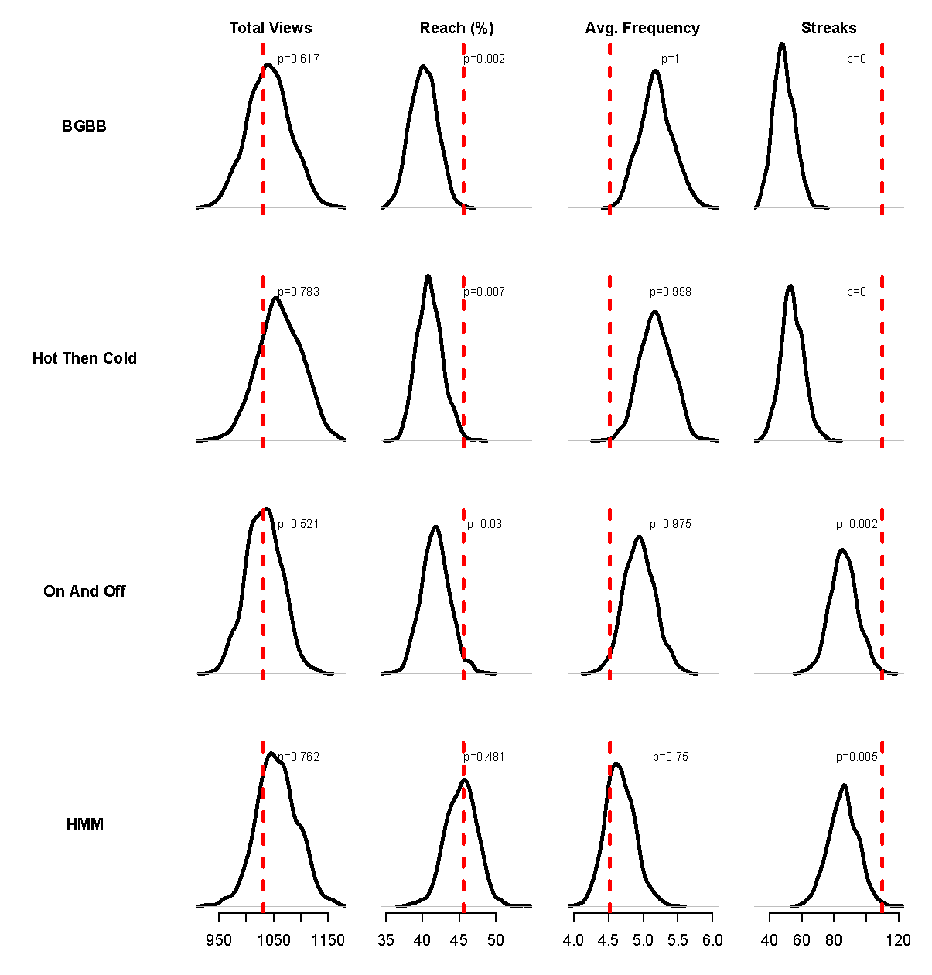
Posterior Predictive Check (In-sample)

Slide 13
From RFM to RFMC

Slide 14
Outline
Propose a new class of clumpiness measures.
Explore its application in customer evaluation.
Show some results for Hulu.com, URBN and other retailers.

Slide 15
New Clumpiness Measures

Slide 16
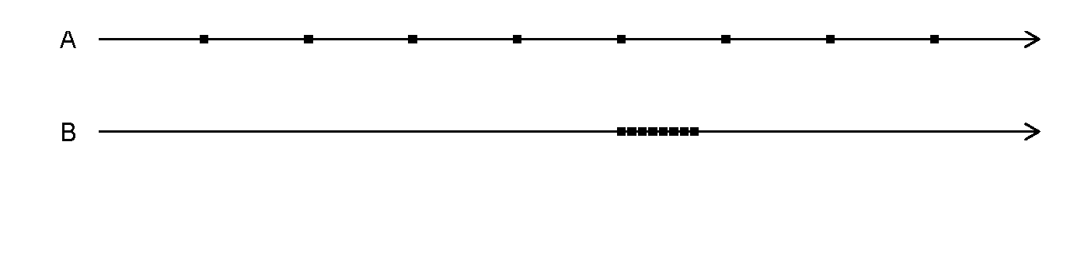
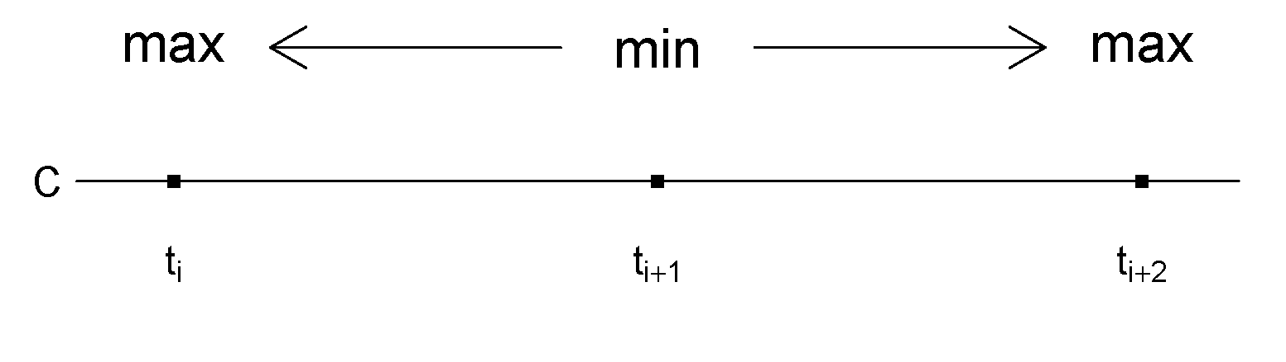
Desired Properties
Minimum: The measure should be the minimum if the events are equally spaced. (A)
Maximum: The measure should be the maximum if all the events are gathered together. (B)
Continuity : Shifting event times by a very small amount should only change the measure by a small amount.
Convergence : As events move closer (further apart), the measure should increase (decrease). (C)

Slide 17
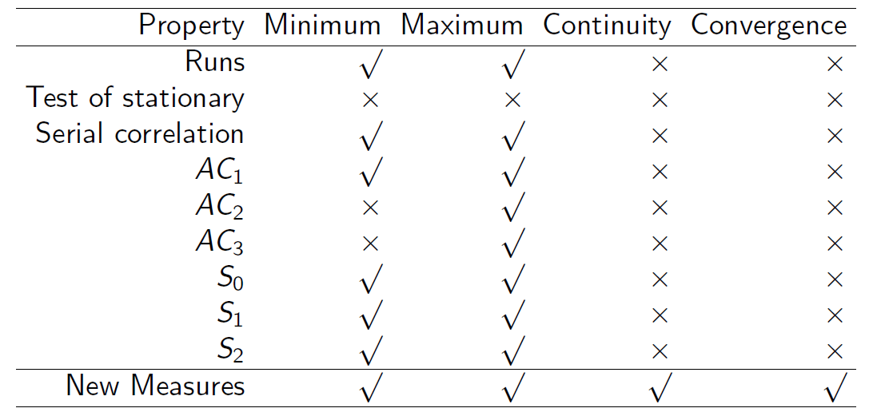
Desired Properties

Slide 18
Development of new measures
Theorem
Any convex and symmetric function of inter-visit (purchase) times satisfies all the desired properties.
The theorem is practically important because it tells us to use the IVTs/IPTs to create new measures.

Slide 19
New measures
Denote inter-visit (purchase) times by ,
Second moment:
Entropy:
Log utility:
Sum of 3 largest components:
Note since their ranges vary significantly, standardization is needed before using them.

Slide 20
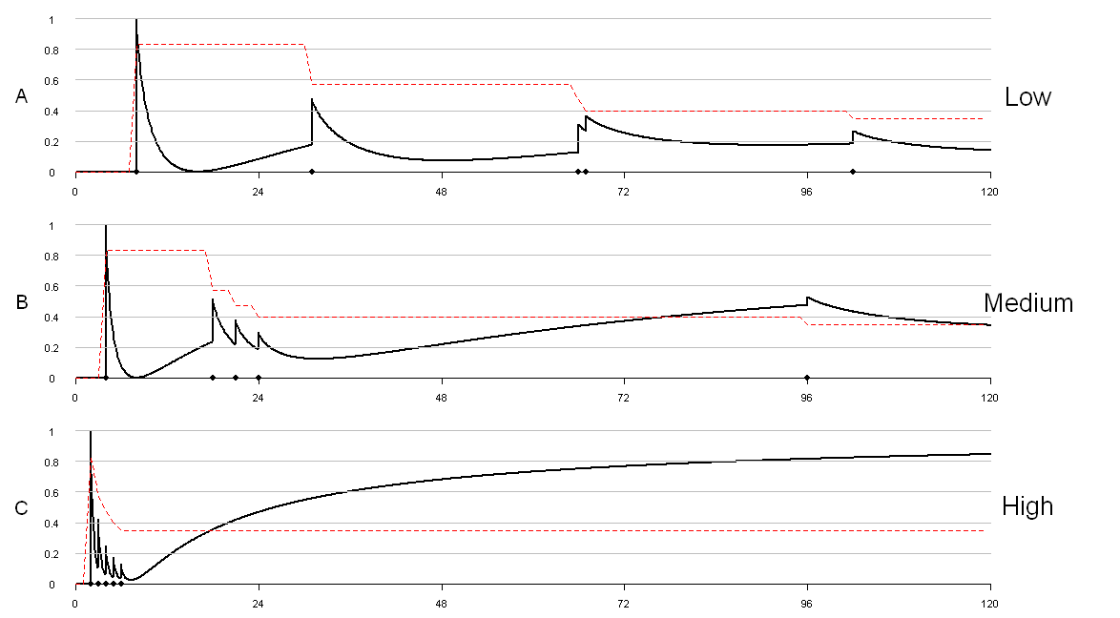
Evolution of Clumpiness

Slide 21
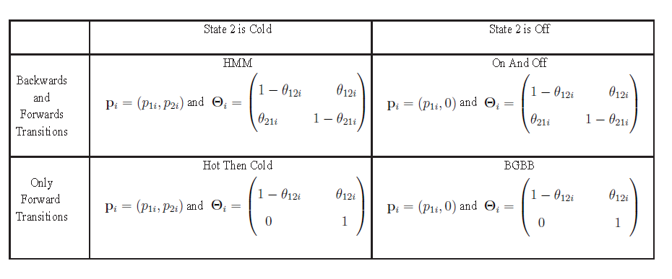
Clumpiness and HMMs

Slide 22
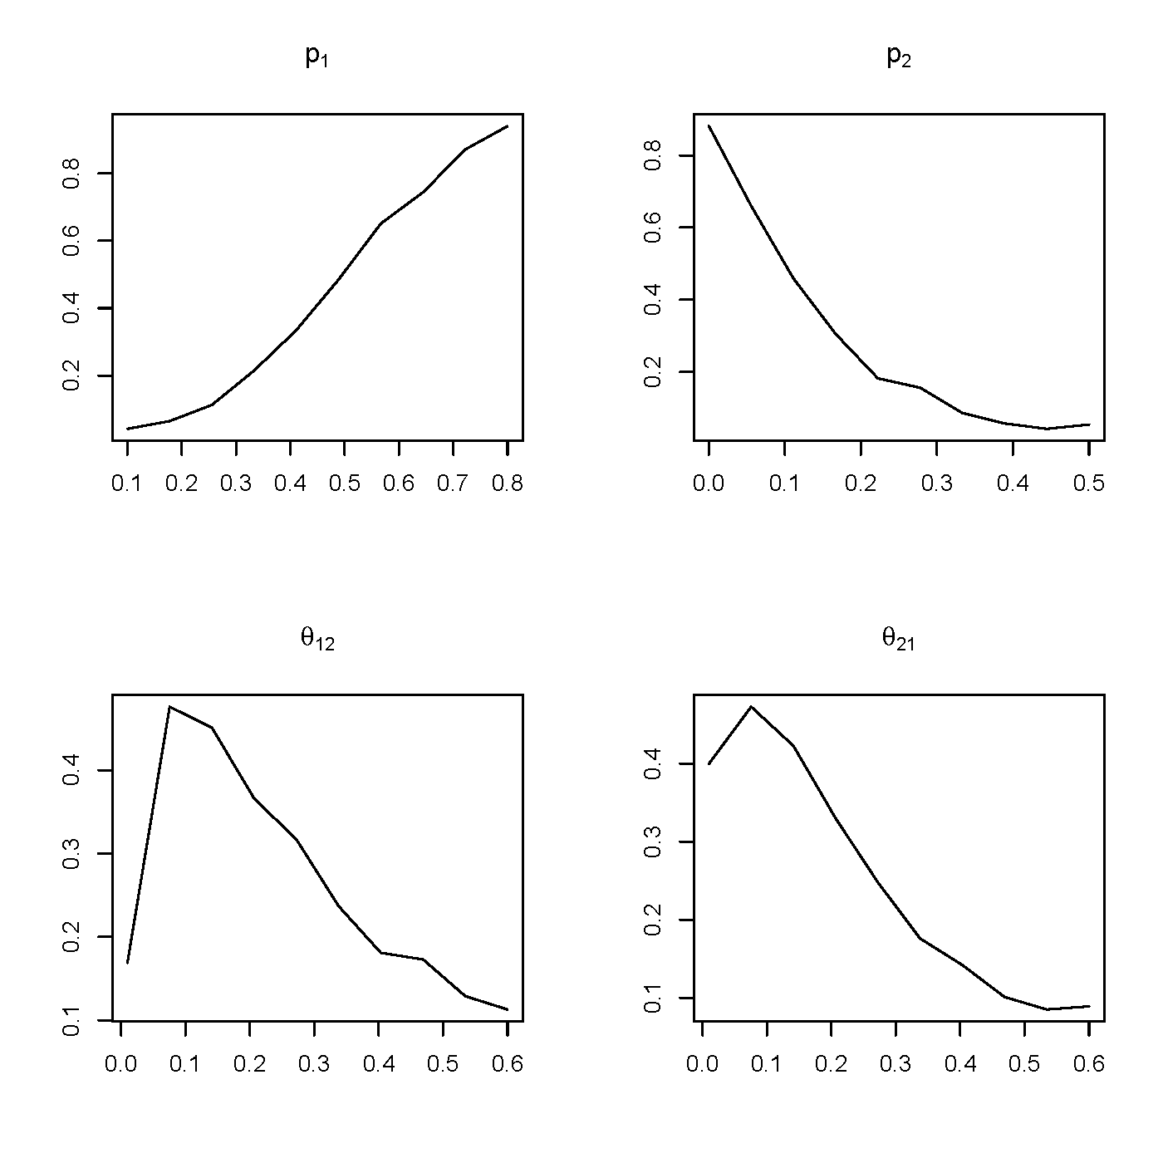
Clumpiness within HMM
HMM is generally considered as a nice model for clumpiness.
Base model:
p₁ = 0.5; p₂ = 0.1,
θ₁₂ = 0.1; θ₂₁ = 0.1,
N = 90.
Vary parameters one at a time.

Slide 23
Simulation Results

Slide 24
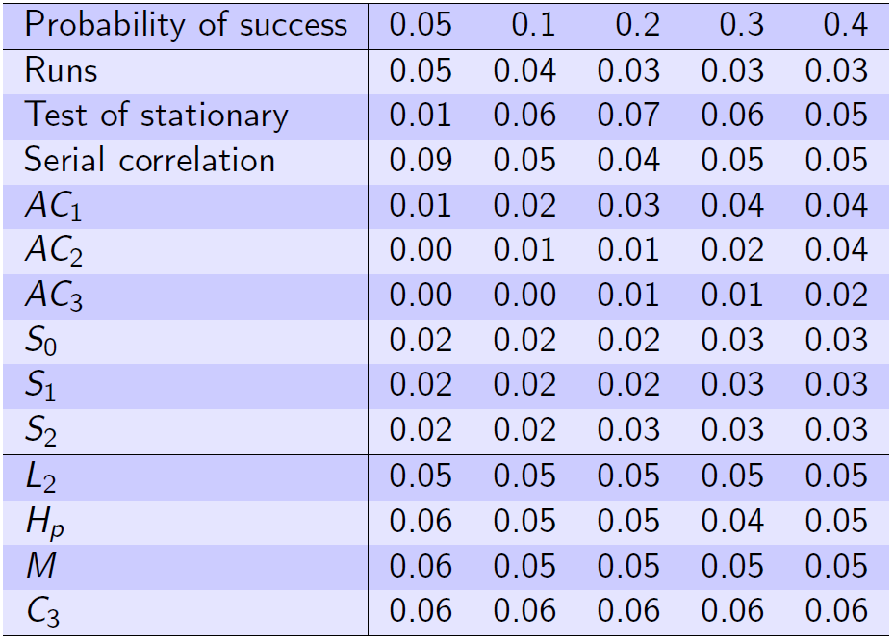
Binomial Model
Use 10,000 iterations, and Type I error are presented:

Slide 25
Non-stationarity Models
One “Hot” spell (Wardrop 1999)
At a random point, the probability of success increase to p_{H} = .5 for 10 more trials, and then returns to p_{B} = 0.05 for the rest of time.
Alternative “Hot/Cold” spells (Dorsey-Palmateer 2004)
Alternative “Hot/Cold” spells with the size of 10. “Hot” and “Cold” periods have respective probability of success.
Regime-shifting (Frame et al. 2003)
The probability of success has a fixed probability(0.1) of switching back and forth between “Hot” and “Cold” regimes.
Regime-shifting with changing switching (Sun 2004)
A similar regime-shifting model but with a changing switching probability which is randomly selected from 0.95 and 0.05 with equal chance for every 10 trials.

Slide 26
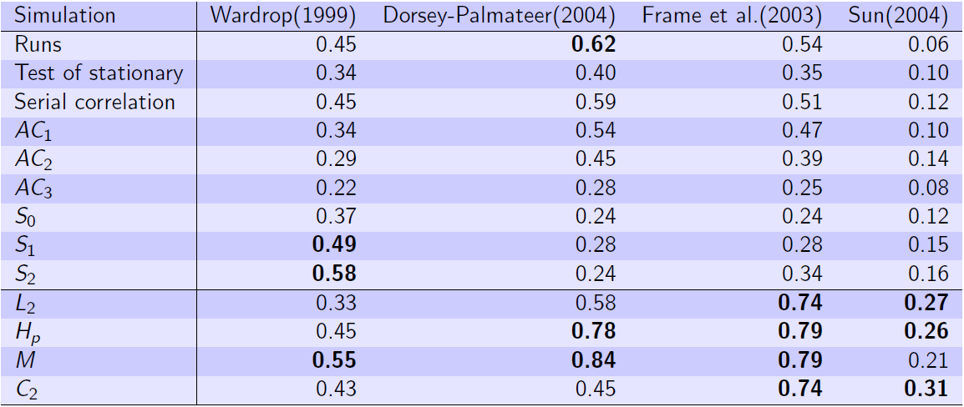
Non-stationarity Results

Slide 27
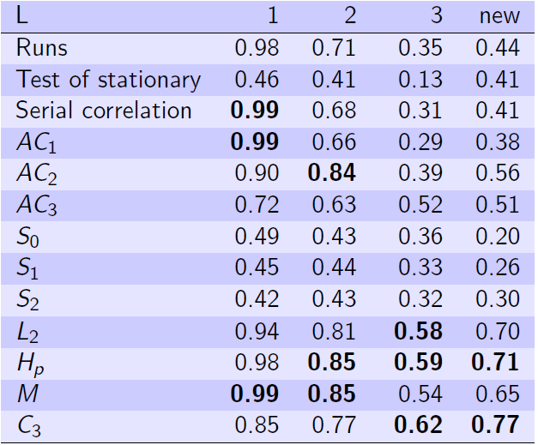
Autocorrelation
Sequential dependence:
The current probability of success depends on the previous outcome.
Using models (Wardrop 1999):
After L or more consecutive successes (failures), the probability of success increases (decreases) to p_{H} (p_{C}).

Slide 28
Urban Outfitters Results

Slide 29
Urban Outfitter Data Description
42,000 customers
Gender
Age
Loyalty program
Wishlist
730 daily data points (2 years)
Click stream (visitation of website)
Marketing
Total
Direct mail
Catalog
Email
Purchase ( 7 subcategories)

Slide 30
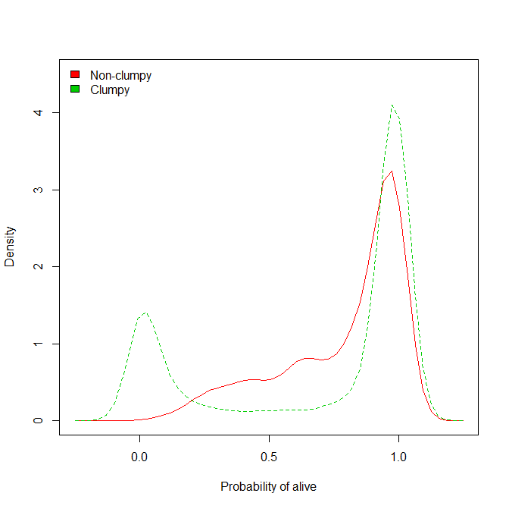
Clumpy individuals have bimodal P(alive)

Slide 31
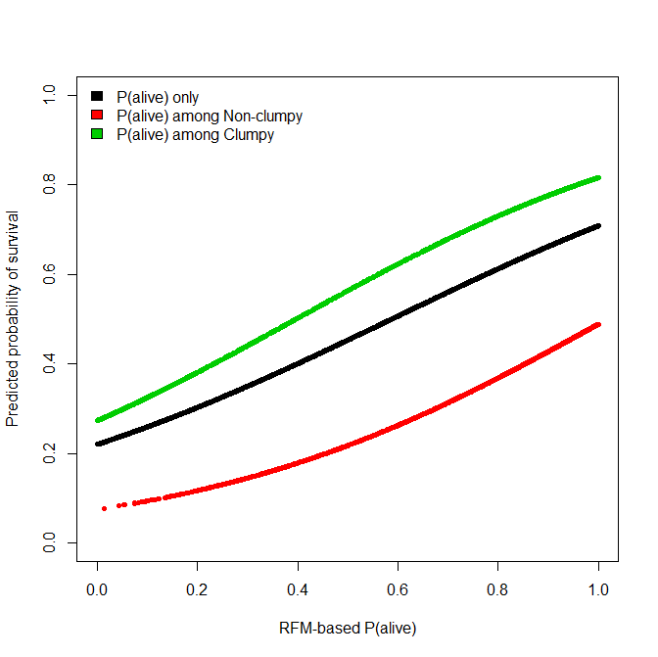
P(alive) is higher for click-clumpy people

Slide 32
Relate clumpiness to person-level characteristics

Slide 33
Purchase clumpiness is less common than visit clumpiness
Visit \ Purchase | Non-clumpy | Clumpy | Total
Non-clumpy | 26% | 3% | 30%
Clumpy | 54% | 17% | 70%
Total | 80% | 20% | 100%

Slide 34
Purchase-Clumpiness varies by product category with an almost 2-1 ratio with the highest being women’s clothing and home goods (15%) and the lowest being kids (7%). For 5/7 categories, Purchase-C is predictive of Purchase-$$$ out-of-sample
Purchase clumpiness by category
Home | Intimate | Kids | Men | Men Acc | Women | Wom Acc
15% | 8% | 7% | 13% | 12% | 15% | 12%
N | Y | N | Y | Y | Y | Y

Slide 35
Regression Results
Purchase-F(IS) | Purchase $$$ (OOS) | Visit-C(IS) | Purchase-C(IS) | Mktg(OOS) | Purchase-F(OOS) | Purchase-F(OOS)
Visit-R(IS) | Visit-R(IS) | Visit-R(IS) | Purchase-R(IS) | Visit-R(IS) | Visit-R(IS) | Purchase-R(IS)
Visit-F(IS) | Visit-F(IS) | Visit-F(IS) | Purchase-F(IS) | Visit-F(IS) | Visit-F(IS) | Purchase-F(IS)
Visit-M(IS) | Visit-M(IS) | Visit-M(IS) | Purchase-M(IS) | Visit-M(IS) | Visit-M(IS) | Purchase-M(IS)
Visit-C(IS) | Visit-C(IS)/Purchase-C (IS) |  |  | Visit-C(IS) | Visit-C(IS) | Purchase-C(IS)
Mktg(IS) | Mktg(IS) | Mktg(IS) | Mktg(IS) |  | Mktg(IS) | Mktg(IS)
Clumpiness Predicts Frequency and $$$
Purchase-C predicts $$$ > Visit-C predicts $$$
Marketing Predicts Clumpiness

Slide 36

Other Data Analyses

Slide 37
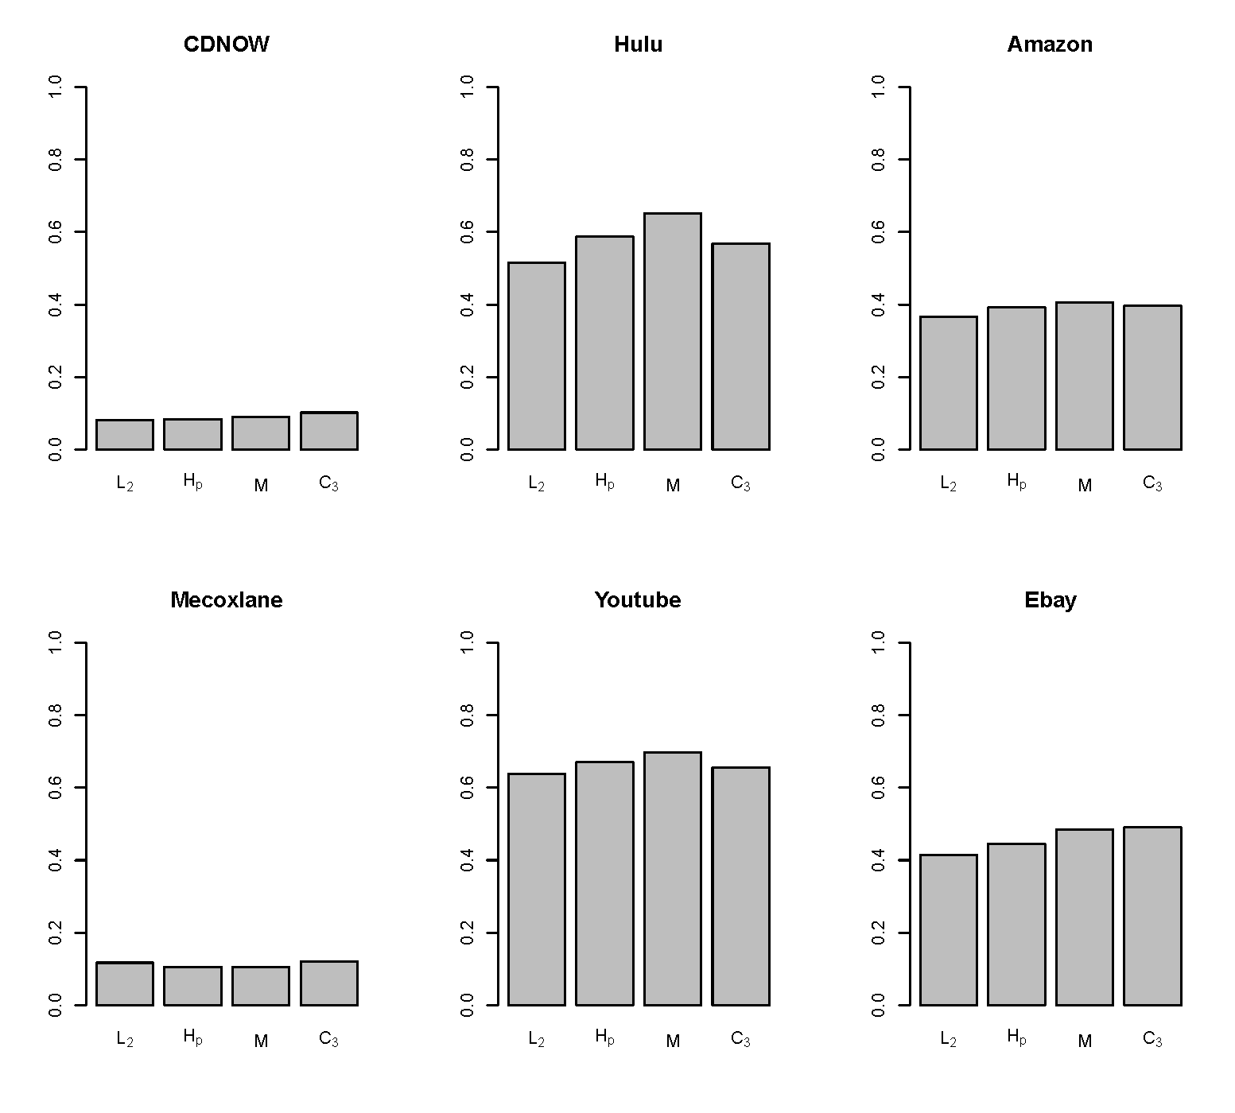
Percentage of “Clumpy” Customers

Slide 38
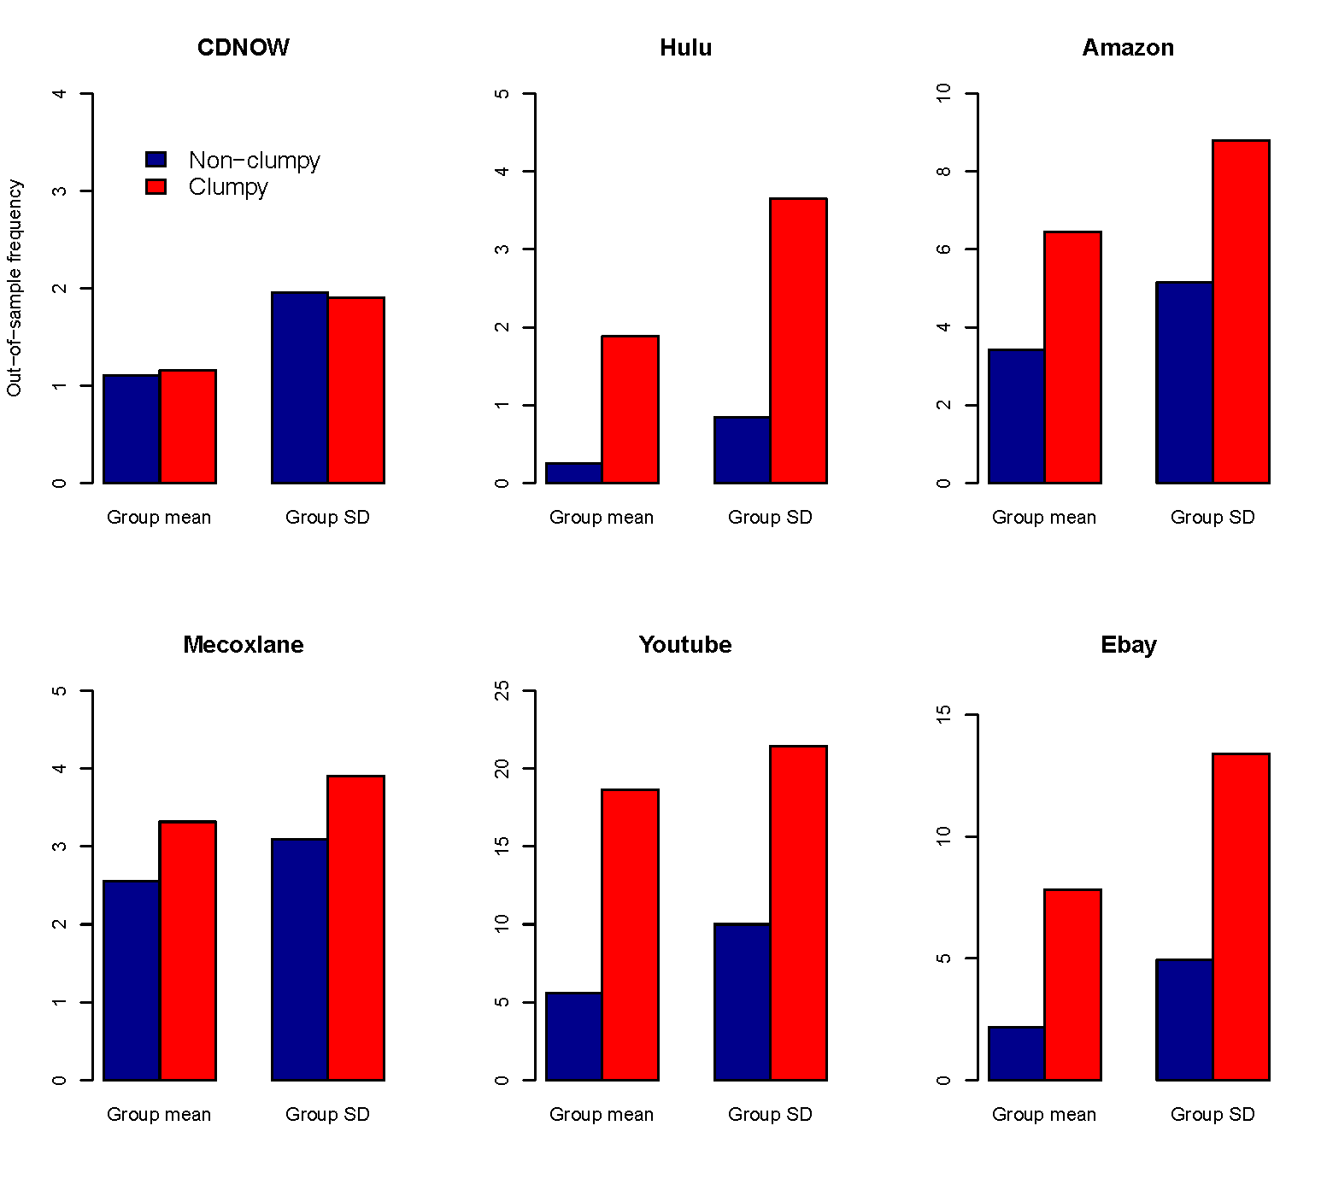
Out-of-sample Frequency

Slide 39
Conclusion
Developed a new class of clumpiness measures which have higher statistical power that existing “hot hand” measure.
Beyond RFM, clumpiness is also an important driver of profiling customers and estimating CLV.
Demonstrated the deficiency in RFM and extended the framework to include clumpiness.
The “clumpiness phenomena” is widely prevalent in the digital consumption and on the internet.

Slide 40
Working Papers
New Measures of Clumpiness for Incidence Data (Applied Statistics, to appear)
Yao Zhang, Eric T. Bradlow and Dylan S. Small
Capturing Clumpiness when Valuing Customers:
From RFM to RFMC
(3rd round at Marketing Science)
Yao Zhang, Eric T. Bradlow and Dylan S. Small

Slide 41
Thank You!

